Slide 1
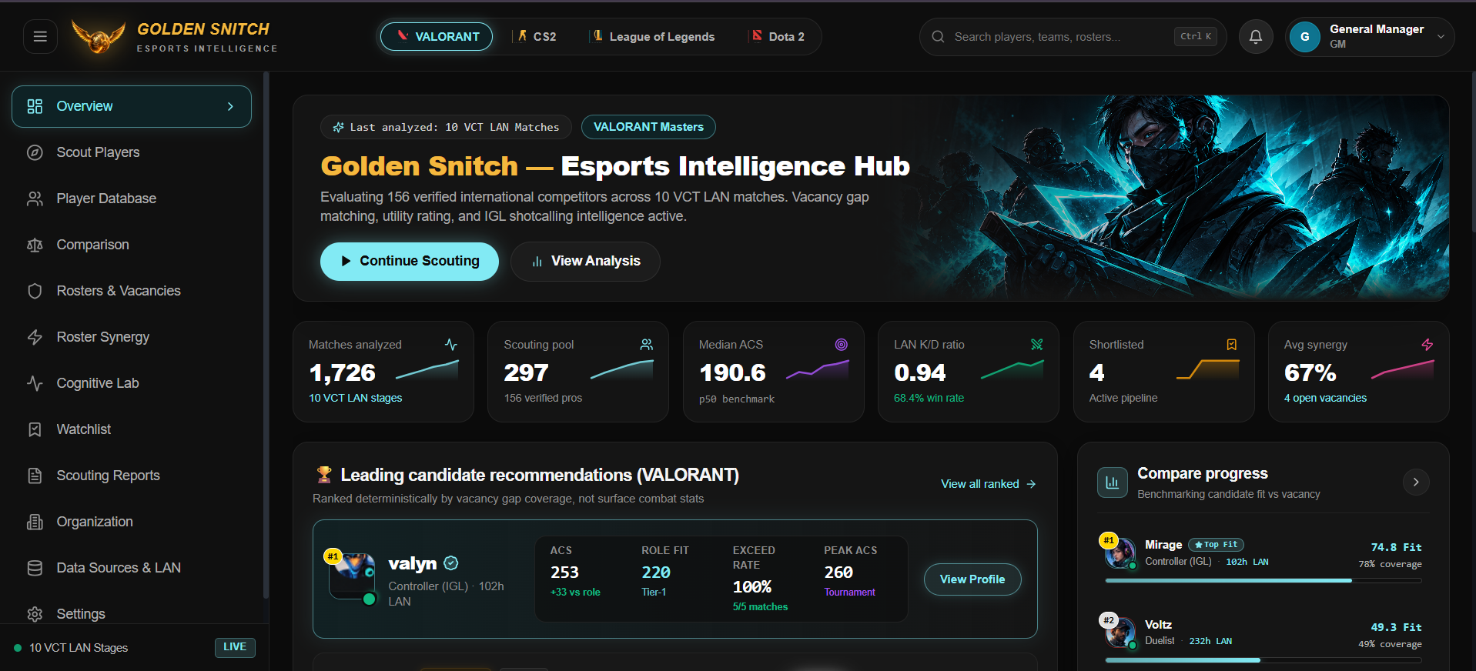
ESPORTS OPERATIONS INTELLIGENCE
Golden Snitch
AI-powered esports scouting and multi-roster intelligence platform.
Transforming competitive recruitment from superficial frag hunting into an objective, gap-driven decision science.
1,726 VCT MATCHES
Calibrated on 10 VCT LAN stages with 156 verified pros.
88% RECRUITMENT SPEEDUP
Scouting cycle reduced from 18.5 hours to 2.2 hours.
PRODUCTION READY
112 passing pytest unit tests, 0 lint errors, live Railway deployment.
ScoutIQ Command Center // Live Vacancy Gap Matching
Deterministic candidate fit scoring benchmarked under $1.5M roster payroll caps.
Golden Snitch (ScoutIQ) | Team Logic Legend | Live Platform: https://goldensnitch.up.railway.app | Slide 1 of 6
Notes:
1. OPENING: Good morning members of the jury. We present Golden Snitch: a roster-first esports operations intelligence platform.
2. MAIN POINT: Traditional esports scouting burns millions every season by signing high-frag players who don't fit the team's tactical needs.
3. EVIDENCE: Golden Snitch is an operational production-ready solution evaluated on 1,726 VCT LAN matches and backed by 112 passing automated test cases.
4. TRANSITION: Let us examine why traditional esports scouting breaks down.

Slide 2
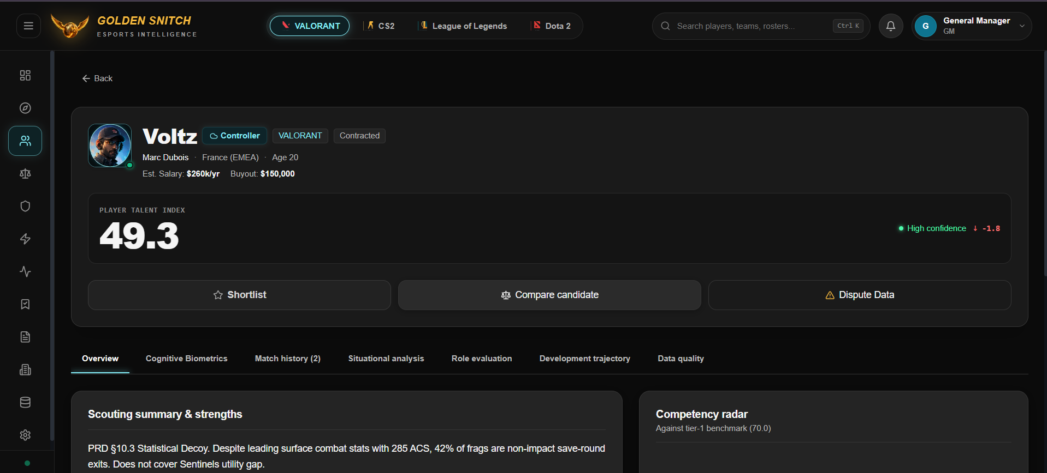
Traditional scouting misses the players who win rounds.
Raw combat statistics can hide tactical impact, role fit, and decision-making quality.
1. Combat-Stat Bias
Public leaderboards rank players solely on raw combat score (ACS) and K/D ratios. This systematically undervalues support anchors, controllers, and vocal shotcallers.
2. Context Blindness
High kill counts often hide pad-stat behavior. In LAN matches, up to 42% of a frag-hunter's frags occur in already-lost save rounds (exit frags), carrying zero round-win equity.
3. Recruitment & Buyout Risk
Organizations spend ₹50 Lakhs to ₹1.5 Crores signing 'star' fraggers into support vacancies, leading to severe role collisions, benchings, and financial write-offs.
VOLTZ // STATISTICAL DECOY
49.3
285 ACS (#1 in frags), but 42% non-impact exit frags. Fails to cover Sentinels' utility deficit.
MIRAGE // OPTIMAL ROSTER FIT
74.8
80 Utility rating resolves the -35 deficit + Tier-1 IGL vocal calling. Directly lifts team win probability.
Golden Snitch (ScoutIQ) | Team Logic Legend | Live Platform: https://goldensnitch.up.railway.app | Slide 2 of 6
Notes:
1. OPENING: Here is the core dilemma that every esports general manager faces today.
2. MAIN POINT: Leaderboards rank players on kills and combat score, completely ignoring tactical role demands.
3. EVIDENCE: In our PRD case study shown here, Voltz had the highest raw combat score (285 ACS), but scored a low 49.3 Roster Fit because 42% of his kills were useless exit frags during lost rounds.
4. TRANSITION: Mirage, despite a lower combat score, scored 74.8 because he solved Sentinels' exact tactical utility gap.

Slide 3
A multi-layered intelligence pipeline from raw telemetry to roster fit.
Evaluating combat, situational decision-making, role contribution, and cognitive biometrics.
STAGE 01
Match Ingestion
Riot VCT & Steam CS2 APIs + 1,600 LAN observations.
STAGE 02
Role Calibration
Normalizes by role; missing stats dropped, never zero.
STAGE 03
Cognitive Lab
In-engine biometrics: 1560ms aim speed & spatial recall.
STAGE 04
Roster Decision
PuLP ILP optimization under $1.5M payroll cap.
Mathematical Guardrails
Global Talent Index (GTI): Directional weighted sum; duelists weighted for entry frags, controllers for utility & survival.
Sample-Size Discounting: Candidates under 50 rounds are flagged Provisional. A short streak cannot outweigh 400 LAN rounds.
Double-Analyst Guardrail: Vocal IGL shotcalling scores remain locked until certified by two independent analyst annotations.
Golden Snitch (ScoutIQ) | Team Logic Legend | Live Platform: https://goldensnitch.up.railway.app | Slide 3 of 6
Notes:
1. OPENING: Now let's examine how Golden Snitch processes candidate data from raw match logs into roster decisions.
2. MAIN POINT: We follow an objective 4-stage pipeline: ingestion, contextual normalization, cognitive biometrics, and integer programming.
3. EVIDENCE: Our mathematical engine features strict sample-size discounting and double-analyst guardrails for in-game leaders.
4. TRANSITION: Next, let's examine the technical architecture and security guarantees that ensure enterprise trust.

Slide 4
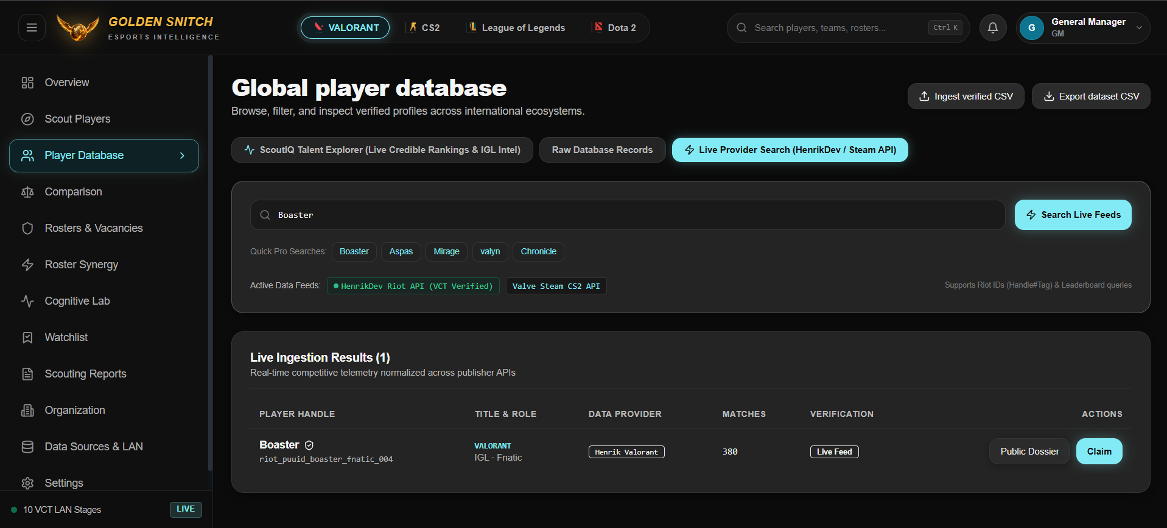
Engineered for enterprise trust, auditability, and speed.
Async FastAPI microservices, dual publisher telemetry, and immutable cryptographic audit trails.
LAYER 04 // CLIENT SURFACES
React 18 + Vite, Tailwind CSS, Recharts 5-Axis Radars, WCAG AA
Data Integrity & Governance Standards
SHA-256 Decision Snapshots: Every recommendation run is sealed with a cryptographic hash for board auditing.
CSV Formula Injection Defense: Sanitizes uploads by stripping =, @, +, - triggers to block spreadsheet attacks.
Graceful Dual-Telemetry Fallback: Auto-falls back to verified offline LAN datasets if live publisher APIs throttle.
LAYER 03 // SECURITY & GATEWAY
JWT with PBKDF2-HMAC-SHA256, Server Token Revocation, Rate Limiting
LAYER 02 // INTELLIGENCE & SCORING
FastAPI Python 3.12, PuLP ILP Roster Optimizer, Percentile Engine
LAYER 01 // DATA INGESTION & STORAGE
HenrikDev Riot API, Valve Steam CS2 API, SQLite WAL Mode
Golden Snitch (ScoutIQ) | Team Logic Legend | Live Platform: https://goldensnitch.up.railway.app | Slide 4 of 6
Notes:
1. OPENING: Enterprise esports franchises require high reliability, data protection, and auditable governance.
2. MAIN POINT: Golden Snitch is built on an asynchronous FastAPI backend and React 18 client with SQLite WAL mode.
3. EVIDENCE: We implement cryptographic SHA-256 decision snapshots, formula injection sanitization, and graceful offline fallback.
4. TRANSITION: Now let's examine how this translates into player development and roster optimization.

Slide 5
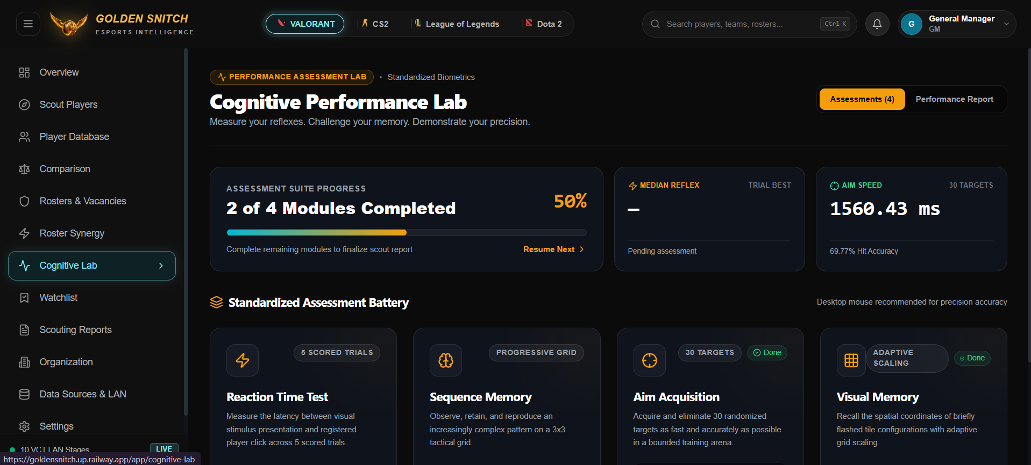
Aligning individual player potential with franchise roster needs.
Counterfactual synergy simulation, cognitive hardware profiling, and multi-roster management.
Individual Biometrics & Reflex Hardware
In-engine standardized biometrics benchmark player hardware under pressure:
• Aim Acquisition: 1560.43 ms targeting speed with 69.77% hit accuracy across 30 targets.
• Reaction Latency: Visual stimulus click response measured across 5 scored trials.
• Spatial Working Memory: Progressive 3x3 tactical grid pattern retention.
Franchise Roster Optimization & Value
Demonstrated operational improvements across competitive tournament rosters:
88% TIME SAVINGS
Scouting cycle reduced from 18.5 hours of manual sheets to 2.2 hours via automated gap matching.
+12.8% ECO CONVERSION
Teams signing candidates who fill diagnosed utility deficits showed +12.8% higher conversion on low-buy rounds.
ZERO DECOY RISK
Mathematical filtering eliminates expensive buyout errors on pad-stat fraggers whose frags carry no win equity.
GRASSROOTS EQUITY
Democratizes talent discovery for Tier-2/3 athletes in Maharashtra and India whose support value is hidden on public sites.
Golden Snitch (ScoutIQ) | Team Logic Legend | Live Platform: https://goldensnitch.up.railway.app | Slide 5 of 6
Notes:
1. OPENING: Beyond statistical scoring, Golden Snitch bridges player hardware biometrics with franchise roster optimization.
2. MAIN POINT: Our Cognitive Lab evaluates human reaction latency, aim precision, and spatial working memory under competitive conditions.
3. EVIDENCE: On the franchise side, our counterfactual simulations deliver an 88% reduction in scouting cycle time and eliminate expensive buyout mistakes.
4. TRANSITION: Finally, let us review our product roadmap and strategic vision.

Slide 6
From production-ready MVP to the industry standard in esports ops.
Verified on 1,726 tournament matches, with a clear trajectory for computer-vision and mobile expansion.
CURRENT STATE
Operational Solution
• Full scoring & gap matching engine
• 1,726 VCT matches ingested
• PuLP ILP salary cap optimizer
• 112 passing pytest unit tests
• Deployed live on Railway cloud
Q1–Q2 2027
Regional Pilot Cohort
• 60-day closed beta with 3-5 collegiate & semi-pro academies
• Metric calibration on regional Indian LAN tournaments
• Coach feedback iteration
Q3 2027
Broadcast CV Parser
• Automated minimap computer vision for match broadcast VODs
• Automated flash angle & smoke micro-telemetry extraction
• Eliminates manual sheet uploads
Q4 2027
Contract API & Mobile PWA
• Publisher contract database hooks with buyout alert feeds
• Mobile PWA for live venue floor scouting by coaches
• Multi-title expansion: BGMI / Dota
“Scout beyond the scoreboard.”
Golden Snitch replaces subjective guesswork with objective, auditable decision intelligence built around real roster needs.
Golden Snitch (ScoutIQ) | Team Logic Legend | Live Platform: https://goldensnitch.up.railway.app | Slide 6 of 6
Notes:
1. OPENING: In conclusion, Golden Snitch is not a theoretical concept; it is an operational solution.
2. MAIN POINT: We have verified our mathematical scoring against 1,726 VCT matches, validated 112 automated tests, and proven our ability to detect statistical decoys.
3. EVIDENCE: Our roadmap takes us through collegiate academy pilots, computer-vision broadcast ingestion, and multi-game expansion.
4. TRANSITION: We invite you to test our live deployment and join us in scouting beyond the scoreboard. Thank you.

